Slide 1
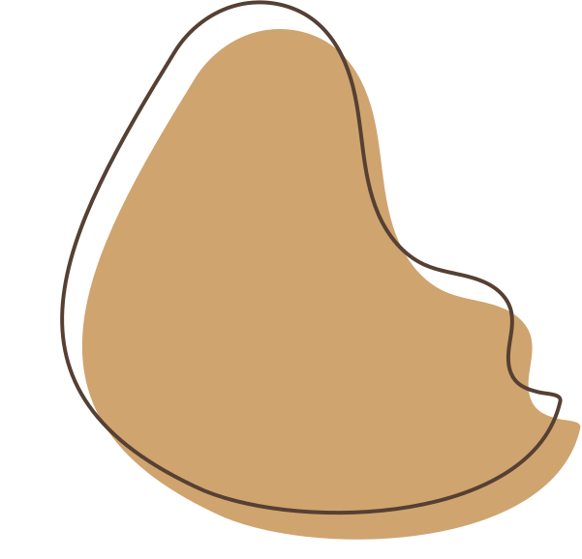

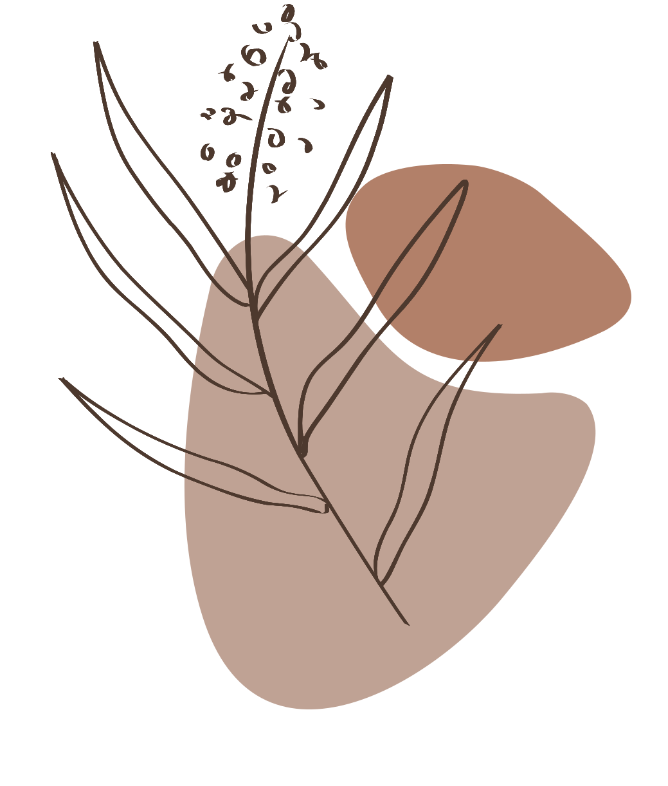
PATHFIT III
by BSCS-2A Group5

Slide 2








TEAM WORK
Mark Acedo
Christian Perez
Karl Miranda
Laira Samis
Ronan Valencia
JM Bernardo

Slide 3

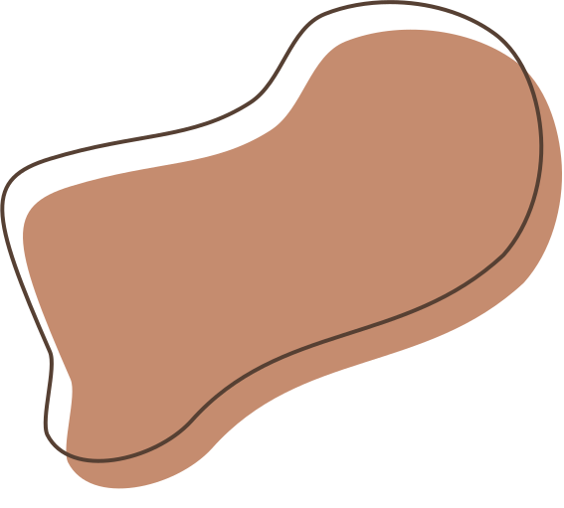
TOPIC
MODERN DANCE

Slide 4








LIST OF CONTENTS
Cultural History
Fitness Benefits
Dance Characteristics
Dietary Goals
Movement Skills
Closing

Slide 5

CULTURAL HISTORY
Modern dance, theatrical dance that began to develop in the United States and Europe late in the 19th century, receiving its nomenclature and a widespread success in the 20th. It evolved as a protest against both the balletic and the interpretive dance traditions of the time.

Slide 6


DANCE CHARACTERISTICS
Modern dance is a style that defies the rigid rules of classical dancing such as ballet.
Instead, it focuses on freestyle movements through the expression of inner feelings.
It also defies the classic attire by dancing barefoot in the early times of modern dancing and now does not have specified costumes.
Moreover, it has been favored by many since the use of weight and gravity for movements created relaxed and free-flowing steps.

Slide 7




MOVEMENT SKILLS
Posture
Alignment
Balance
Coordination
Control
Flexibility
Mobility
Strength

Slide 8





FITNESS BENEFITS
FULL-BODY WORKOUT
CORE STRENGTH
Modern dance engages various muscle groups throughout your body, helping to tone muscles, improve strength, and enhance overall muscle coordination
The emphasis on controlled movements and dynamic transitions in modern dance can help strengthen your core muscles, leading to better stability and posture.

Slide 9
FITNESS BENEFITS
CARDIOVASCULAR
INCREASES ENERGY
Like other aerobic exercise, dancing is great for improving cardiovascular function—which can lead to a stronger and healthier heart.
Many forms of dancing, including modern dances, improve adults’ physical performance and increase their energy levels.

Slide 10



DIETARY GOALS
As a rule, dancers are advised that their overall diet should take at least 50-65% of its energy from carbohydrate; around 12-15% should come from protein; and less than 20-35% from fat. This advice is very similar to that given to other elite sportspeople.

Slide 11


MODERN DANCE EXAMPLE

Slide 12

THANK YOU
by BSCS-2A Group5

